Slide 1
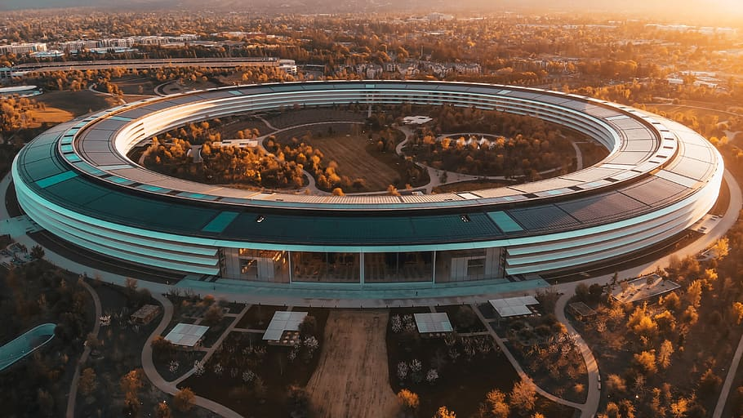

Strategies For Successful Business And Group Meetings
Background information on groups purpose, solving problems in meetings or groups, agenda, minutes.

Slide 2


What is a group meeting in business:
Gathering of two or more people on the purpose of decision making

Slide 3
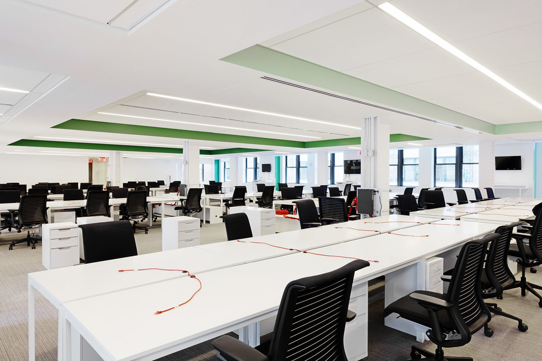
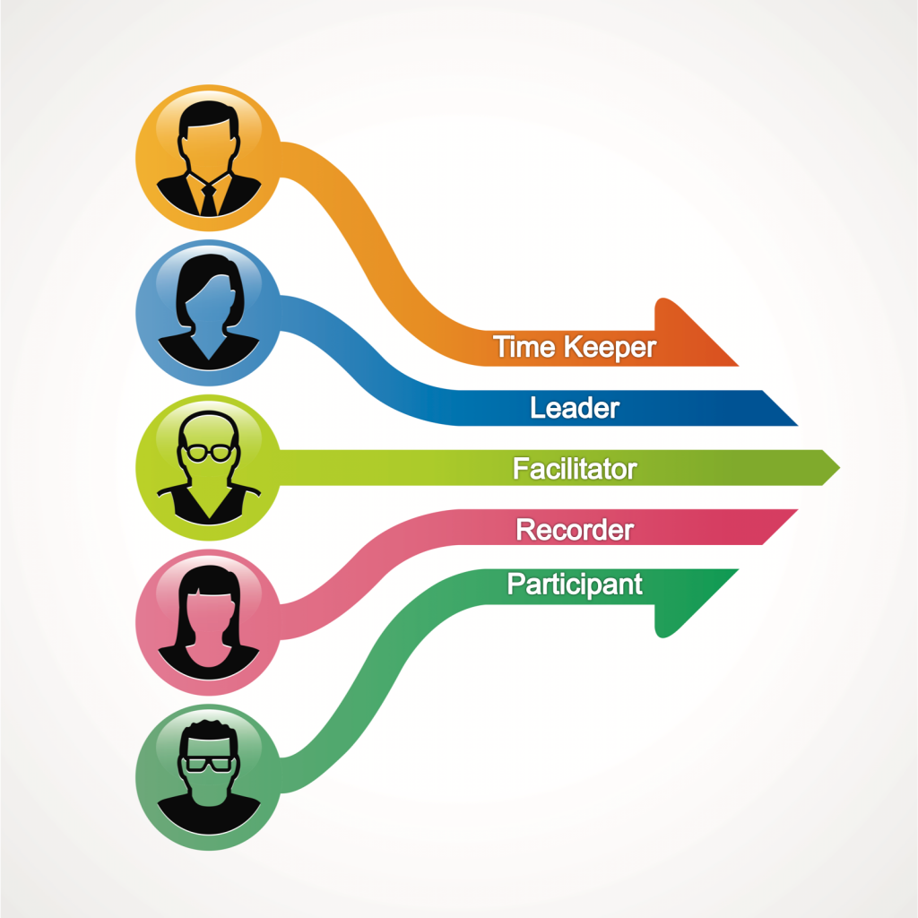
General Background Information On Group:
The Leader
The Recorder
The Time Keeper
The Facilitator
The Participants

Slide 4


Purpose and kinds of meetings:
Develop new ideas
Plan for workplace
Solve Problems Collectively
Encourage Enthusiasm
Improved performance
Make Collective Decisions
Share Information With The Team
Measure Results
Discuss the status of activities.
Formal Meeting
Informal Meeting
Company Meeting
Statuary Meeting
Director Meeting
Annual Meeting
Private Meeting
Public Meeting

Slide 5

Solving Problems In Meetings:
Show up on time
Stay Mentally And Physically Present
Come Prepared
Let Everyone Participate
Listen With an open mind
Think before speaking
Contribute to meeting goals

Slide 6

MINUTES AND AGENDA
To make solutions
To solve problems
To record activities
To decide next meeting date and time
Topic of discussion & place.

Slide 7
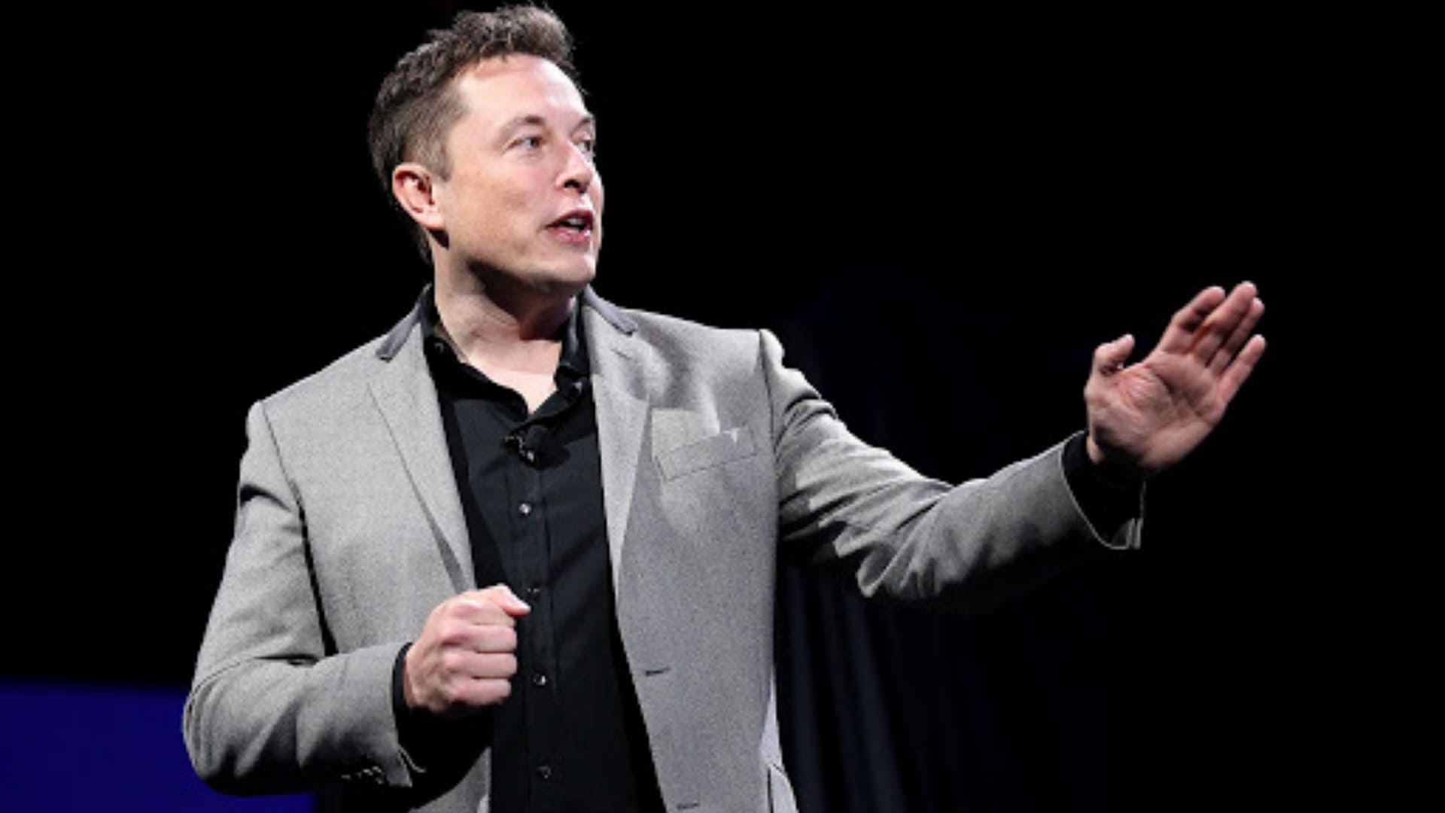

Leader Responsibilities
Determines meeting location, time, attendees
Develops an agenda
Guides the group
Ensures equal speaking opportunities
Maintains a positive atmosphere
Assigns other meeting roles
Sets next meeting date
Communicate next step and conclusion.

Slide 8


Participants Responsibilities
Understand the agenda
Contributes to positive atmosphere
Contributes insights of the agenda items
Present ideas.

